Slide 1
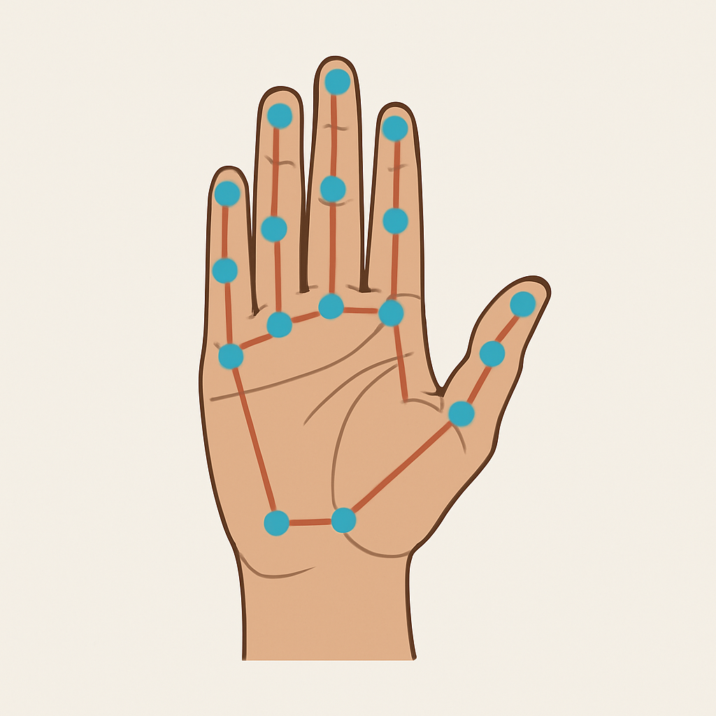
REAL-TIME WORD-LEVEL SIGN LANGUAGE RECOGNITION
Major Project Presentation
B.Tech – Artificial Intelligence & Data Science (2021–25)
Presented By:
Jayant Kathuria
Ashish Garg
Guided By:
Dr. Amrit Pal Singh
Assistant Professor, USAR

Slide 2
Why This Project?
Millions of deaf individuals face communication barriers daily.
Most people don't understand sign language.
This leads to isolation in schools, hospitals, and public places.
Existing solutions are limited.
Many systems require expensive gloves or sensors.
Few work in real time — even fewer support multilingual users.
We wanted to build a system that gives sign language a voice.
Simple, fast, real-time.
Works with just a webcam.
Translates signs to Hindi, Urdu, Punjabi and speaks them aloud.

Slide 3
Our Vision – Project Objectives
Recognize ASL gestures in real-time using webcam input
Extract 3D hand landmarks using MediaPipe for pose estimation
Train a CNN-LSTM hybrid model to classify 15 ASL signs
Enable multilingual translation (Hindi, Urdu, Punjabi) using offline JSON
Provide audio output via text-to-speech to simulate spoken response
Ensure the system is offline-friendly and runs on low-end hardware
Offer a simple, intuitive user interface using OpenCV

Slide 4
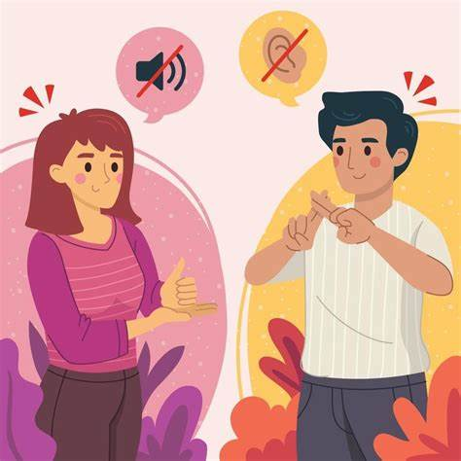
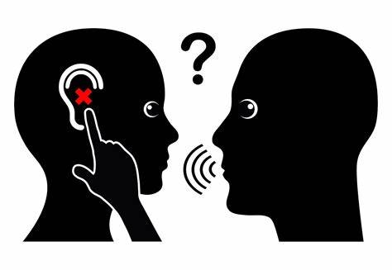
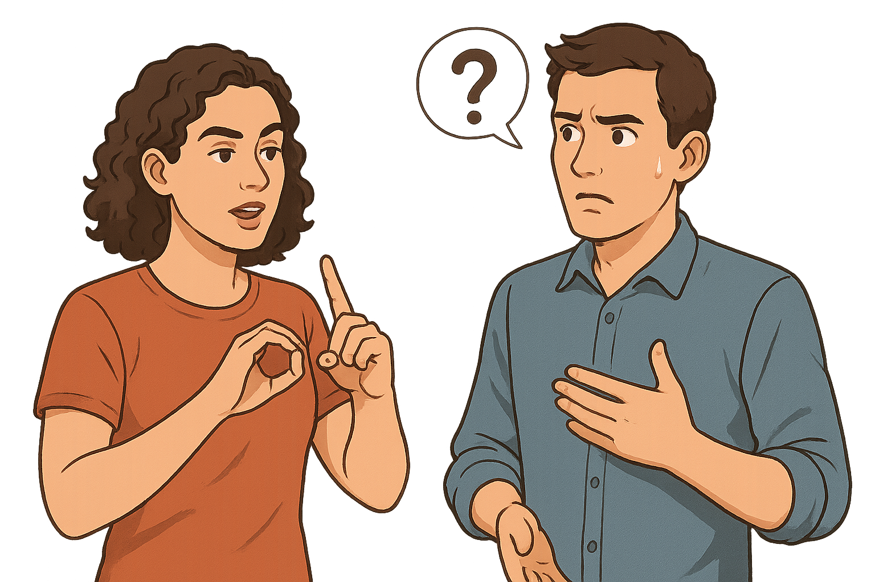
The Communication Gap

Slide 5
The Communication Gap
Sign language is the first language for millions in the deaf and hard-of-hearing community.
Yet, most people do not understand even basic ASL gestures.
This creates serious barriers in:
Education
Healthcare
Jobs and services
Daily communication
The result? Isolation, misunderstanding, and exclusion.
Current solutions often require:
Expensive gloves or hardware
Limited language support
When language becomes a barrier, even asking for help becomes impossible.

Slide 6

Literature Review – What Exists
Approach | Pros | Cons
Sensor-Based | High accuracy | Impractical, expensive
Traditional ML | Lightweight | Not scalable
CNN-LSTM | Accurate | Often not real-time
MediaPipe | Real-time, no sensors | Rarely used for multilingual speech

Slide 7
Our Approach
MediaPipe for 3D Hand Tracking: No gloves or hardware needed — just a webcam
CNN-LSTM Hybrid Architecture: Combines spatial understanding (CNN) with temporal flow (LSTM) for better sign recognition
Buffer-Based Prediction Smoothing: Improves real-time stability and reduces flickering predictions
Multilingual Translation (Offline): Mapped each sign to words in Hindi, Urdu, Punjabi using custom JSON
Offline Text-to-Speech Output: Uses pyttsx3 for fast, local speech synthesis — no dependency on APIs
Runs on Low-End Hardware: Designed for laptops with CPU only — no GPU or cloud service required

Slide 8
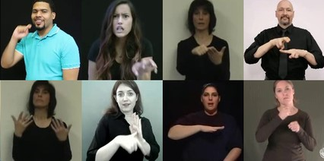
Dataset – What We Used to Train the Model
Primary Dataset: WLASL (Word-Level American Sign Language)
Publicly available dataset with labeled ASL videos
Contains multiple signers, variations in speed and hand shape
Selected 15 Signs for This Project
Selected signs: ['ball', 'bird', 'black', 'candy', 'color', 'cousin', 'forget', 'hearing', 'mother', 'no', 'now', 'orange', 'water', 'wrong', 'yes']

Slide 9
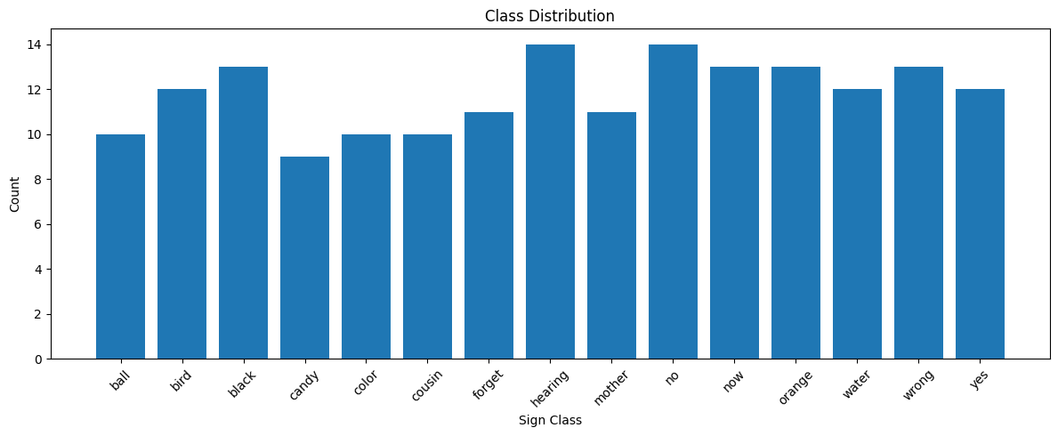
Dataset – How We Used the dataset to Train the Model
Class Imbalance Handling
Used data augmentation: random flips, scale, and shifts
Ensured each class had similar sample size to improve fairness
Preprocessing
Extracted 3D (x, y, z) keypoints per hand using MediaPipe
Normalized coordinates to make model invariant to camera distance

Slide 10
System Architecture
Step-by-Step Breakdown:
Webcam Input
Captures live video stream of hand gestures
MediaPipe Hand Detection
Detects 21 3D landmarks per hand in real-time
Keypoint Extraction & Sequence Buffering
Buffers 30 frames of landmarks for temporal modeling
CNN-LSTM Model Prediction
Classifies the sign from the buffered keypoints
Prediction Buffer
Stores last 5 predictions and displays the most repeated word
Translation Module
Maps recognized sign to multilingual output (Hindi, Urdu, Punjabi) (pre-generated and stored using googletrans api)
Text-to-Speech Output
Speaks the translated word using pre-stored audios (generated using pyttsx3 api)

Slide 11
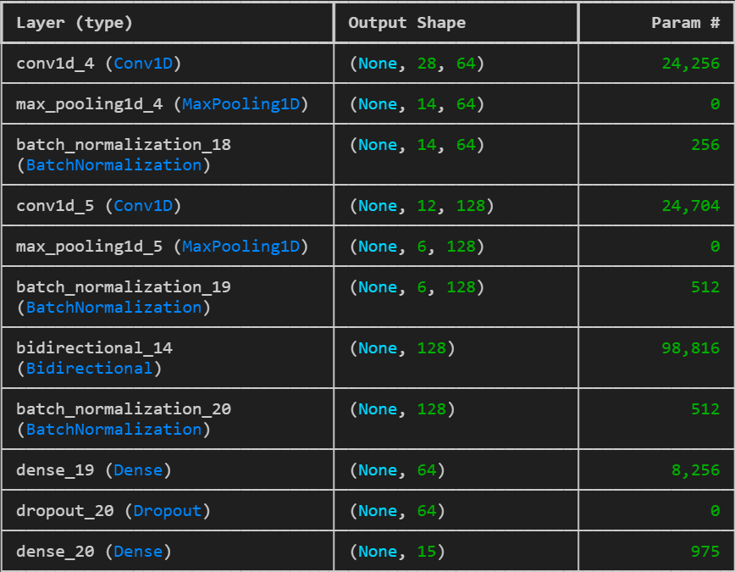
Model & Training – How We Built the Brain of the System
Model Architecture: CNN-LSTM Hybrid
CNN layers for spatial feature extraction from hand keypoints
LSTM layers for understanding temporal movement across frames
Final Dense layer with softmax activation to classify among 15 signs
Input Format
Each input: sequence of 30 frames
Each frame: 63 values (21 hand keypoints × 3D)

Slide 12
Model & Training – How We Built the Brain of the System
Training Setup
Optimizer: Adam, Loss: Sparse Categorical Crossentropy
Epochs: 100, EarlyStopping and ReduceLROnPlateau used
Batch size: 16, Validation split: 20%
Regularization & Techniques
Dropout layers to avoid overfitting
L2 regularization in convolutional layers
Buffer smoothing for stable real-time prediction
Augmentation & Class Weights
Used random time jittering and oversampling for rare signs
Handled imbalance using class weights during training

Slide 13
What We Built?
Live Sign Detection from Webcam
System detects ASL signs from live webcam feed
Keypoint Tracking Using MediaPipe
Real-time 3D landmark extraction, no special equipment needed
CNN-LSTM Prediction Buffer
Smooth gesture recognition with buffered prediction logic
Multilingual Translation
Recognized word is instantly translated to Hindi, Urdu, or Punjabi
Text-to-Speech Output
Translated word is spoken aloud for better accessibility

Slide 14
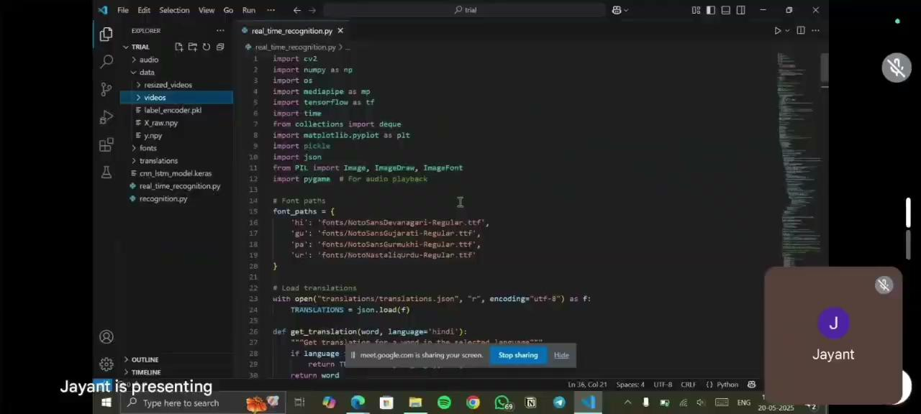
Real Time Demo

Slide 15
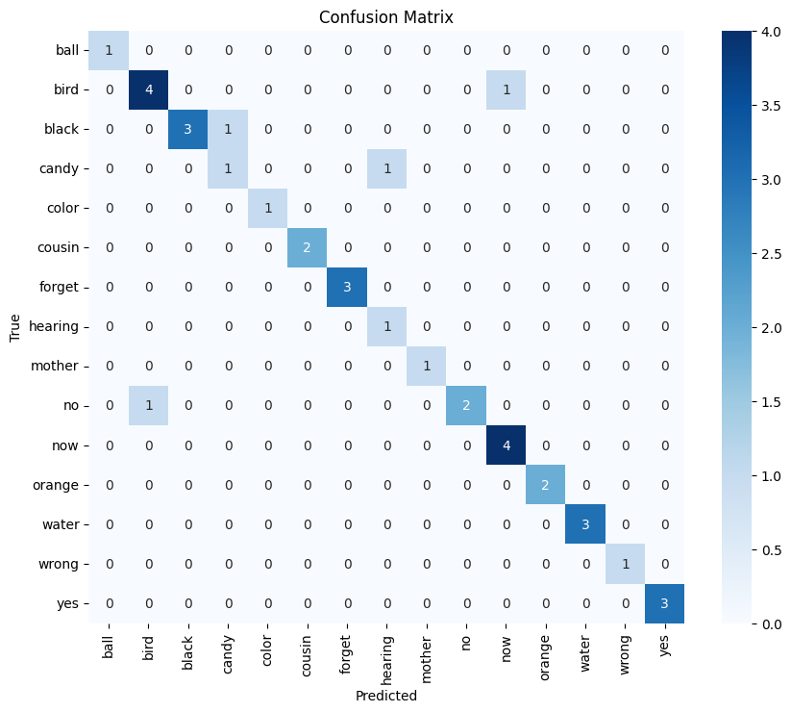
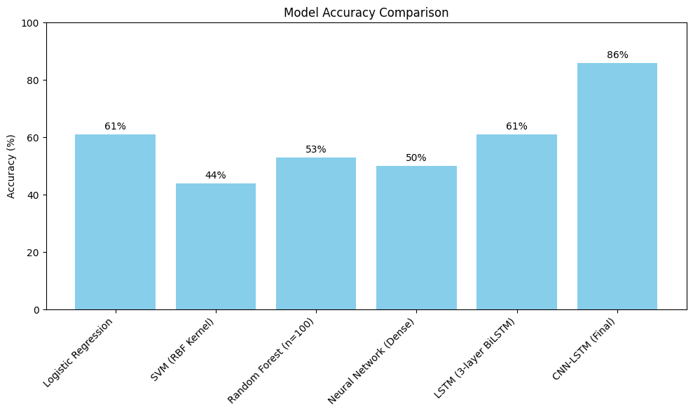
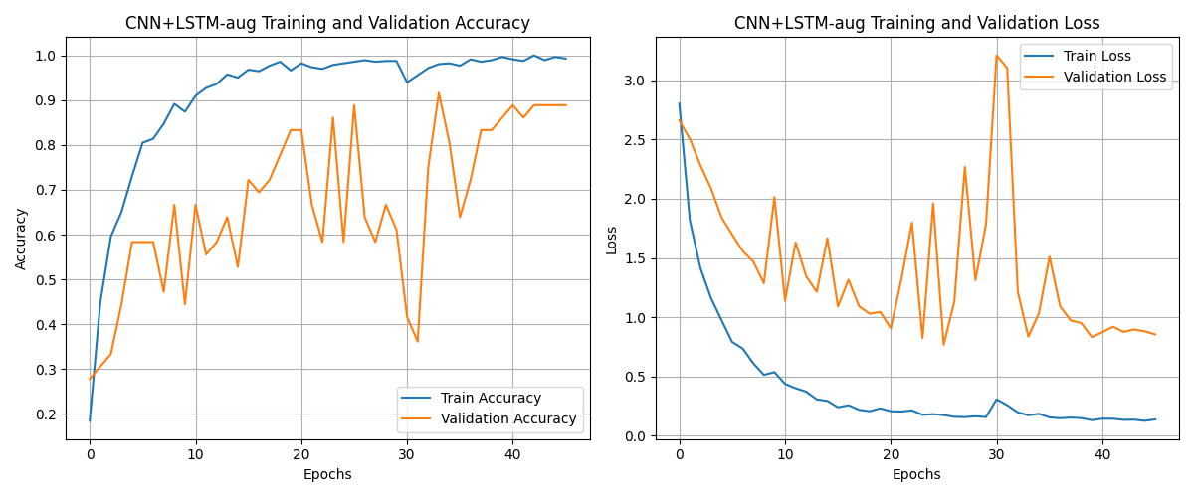
Results & Performance
Model Accuracy
Achieved training accuracy ~95% and validation accuracy ~88%
Balanced across most sign classes
Performance Metrics
Macro F1-score: 0.84
Precision / Recall: Consistently above 80% for common classes
Tested in Real-Time
Prediction speed: ~20–25 FPS
Runs smoothly on CPU (no GPU dependency)

Slide 16
Challenges Faced
Data Imbalance Across Classes
Some signs had far fewer samples in WLASL
Solution: Applied augmentation, and used class weights
Real-Time Stability
Live prediction flickered due to hand jitter & misclassifications
Solution: Introduced a frame buffer and majority voting for smoothed output
Streamlit & Webcam Issues
Streamlit camera lagged or froze on local deployment
Solution: Switched to OpenCV-based UI for better performance
Multilingual TTS Integration
Text-to-speech in multiple languages was tricky without online APIs
Solution: Created offline translation using JSON + pyttsx3 for local speech

Slide 17
What We Learned
What’s Next?
Model Design & Optimization: Learned to balance accuracy and speed for real-time use with CNN-LSTM
Handling Real-World Data Problems: Managed class imbalance, noise, and variability across signers
System Integration: Combined CV, DL, translation, and TTS modules into a full pipeline
Teamwork & Communication: Delegated roles, debugged issues collaboratively, adapted under pressure
Increase Vocabulary: Extend to 50+ signs or even sentence-level recognition
Deploy as a Mobile App: Use TensorFlow Lite or ONNX for Android/iOS deployment
Bidirectional Communication:Enable speech-to-sign translation for complete interaction loop
More Languages & Dialects: Add support for more regional Indian languages and accents
Train on Diverse Signers:Use a larger dataset with different backgrounds, skin tones, and hand sizes

Slide 18
THANKS

